Slide 2
PIPELINE INSULATION
Advanced Material
Technology

Slide 3
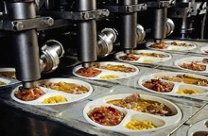
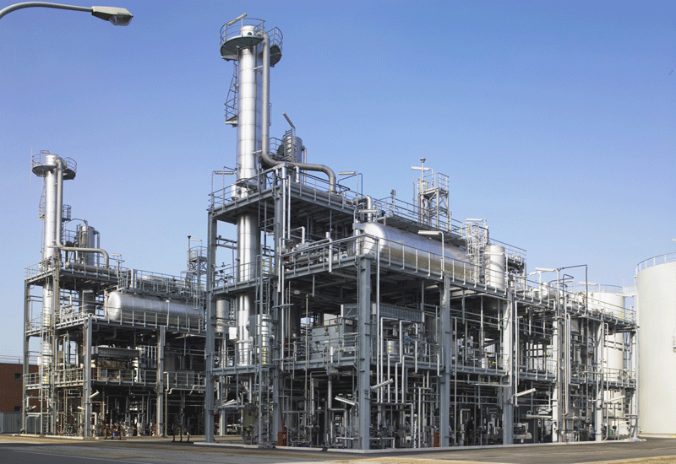
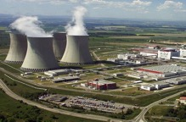
OUR MATERIAL and TECHNOLOGY are APPLICABLE TO MANY SECTORS
Food industry, including operations with the strictest hygiene
Health care, a wide variety of uses
Including the latest nanotechnology
Petrochemical and chemical industries
Nuclear energy

Slide 4
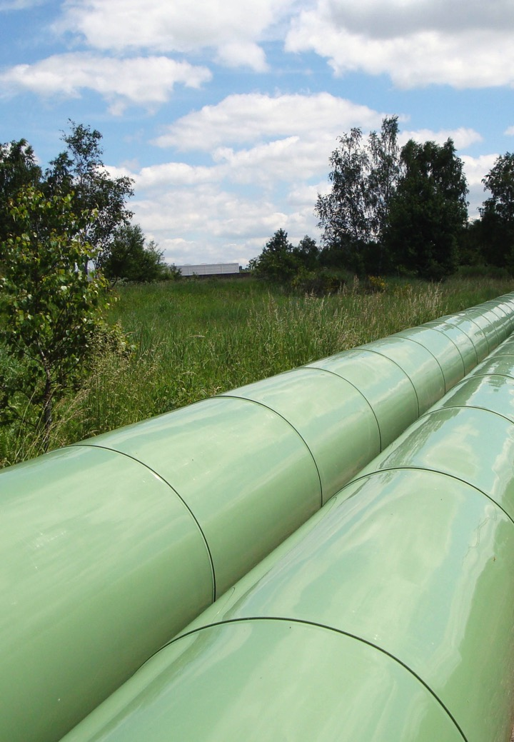

Slide 7
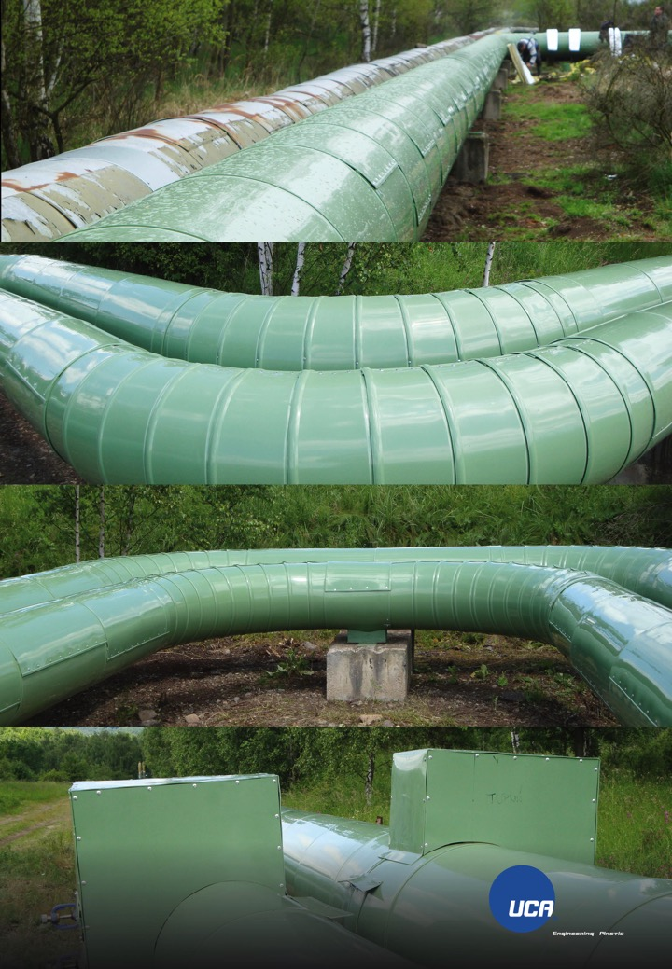

Slide 13
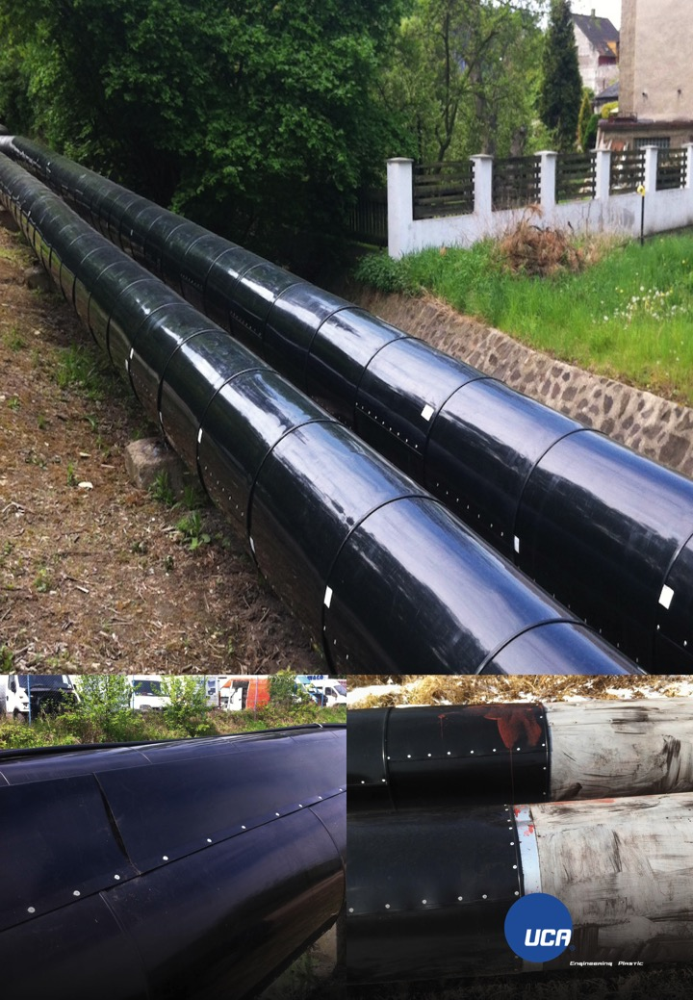

Slide 17
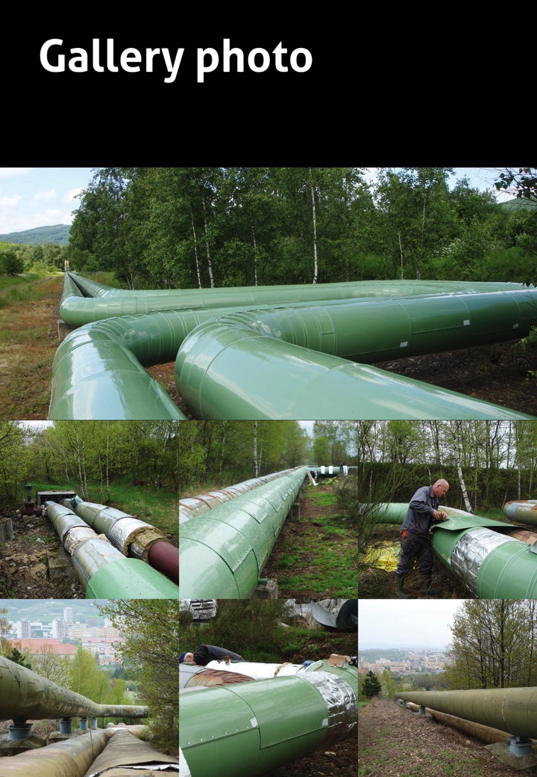
Our Work in Photos

Slide 18
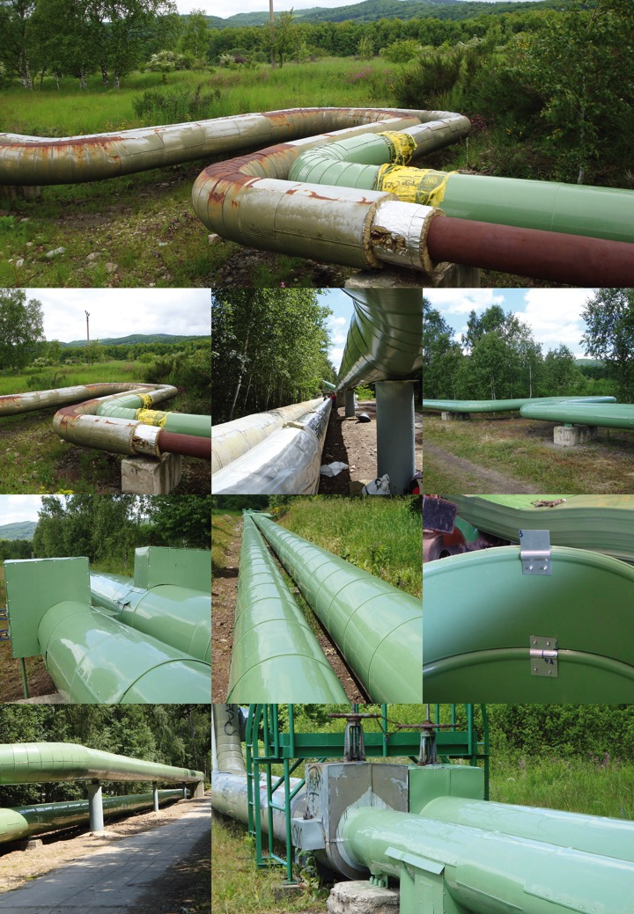

Slide 19
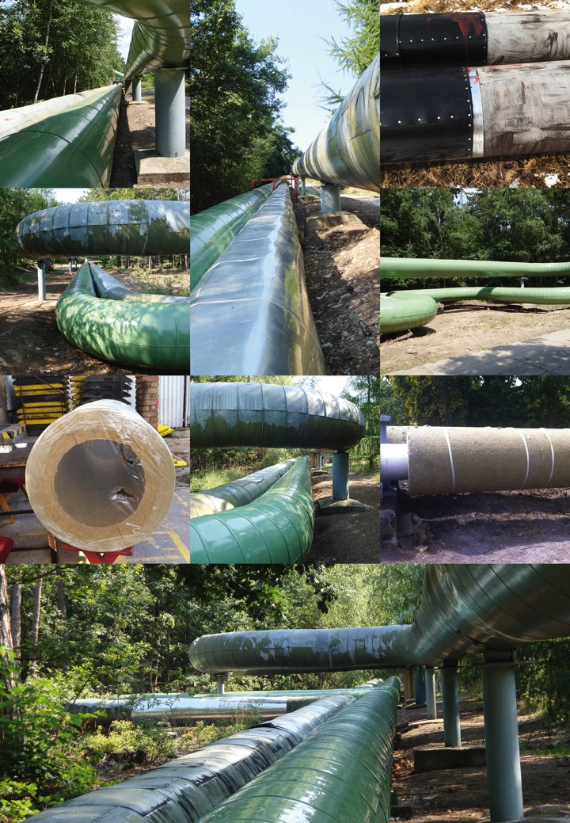

Slide 20
FFILIP JÍCHA CEO

